Slide 1




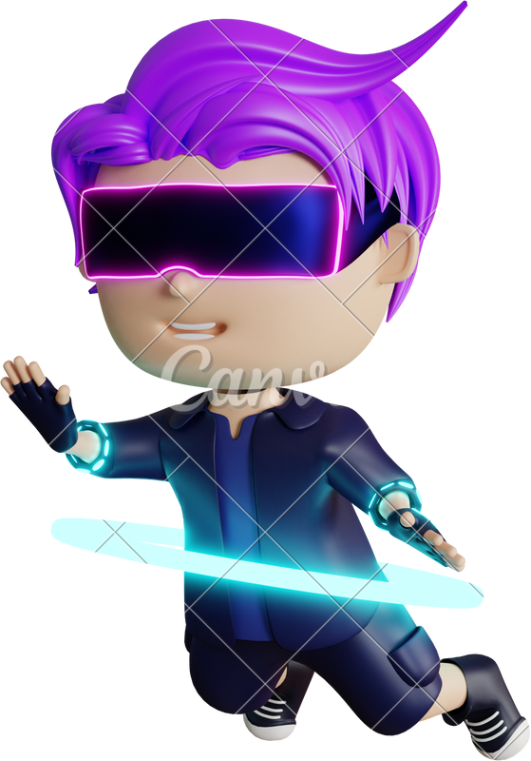

WIZARDY WHIZKIDS
ADITYA KUMAR JHA
PRAJWAL JHA
YASH SHEKHAWAT
TANMOY ROY CHAMAK

Slide 2


TABLE OF CONTENT
PROBLEM STATEMENT & INSPIRATION
IDEA
APPROACH
FUTURE SCOPE OF WORK

Slide 3




PROBLEM STATEMENT & INSPIRATION
Public speaking is a common and essential skill for various personal and professional purposes, such as education, career, or social interaction. However, many people experience fear, anxiety, or lack of confidence when faced with public speaking situations, which can affect their performance and communication. Moreover, traditional public speaking training methods may not be accessible, affordable, or effective for everyone, and may not provide enough practice, feedback, or customization.Women (70%) are more likely than men (57%) to experience glossophobia.
According to Statistics, Virtual reality (VR) based training has been shown to
reduce public speaking anxiety by 52%.

Slide 4

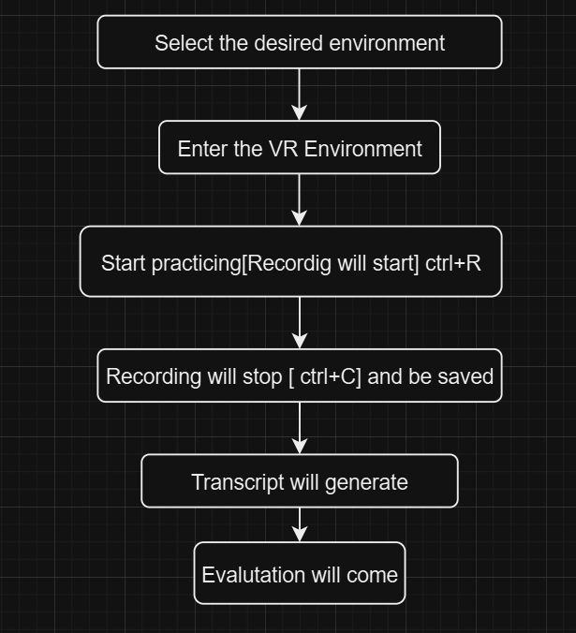
VR SPEECH STUDIO
VR Speech Studio is a VR app that allows users to create and customize their own virtual public speaking experiences, by
choosing from a variety of audiences, scenarios, and speeches. The app can also provide feedback, challenges, and rewards for the users to improve their public speaking skills and confidence.
The app can enable users to build their own audience, master their own speech, challenge their own skills, and reward
their own progress, using VR technology

Slide 5


APPROACH
1.Develop VR environment: develop a virtaul environment to replicate a real life situation using 3D models.
Backend: integrated backend to record the sound and convert it to transcript using Google API for evaluation.
Evaluation: Transcript will be sent and report will be generated by openAI API.

Slide 6

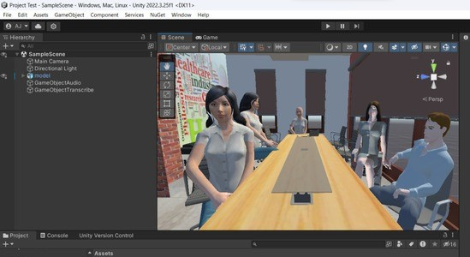
VR ENVIRONMENT

Slide 7

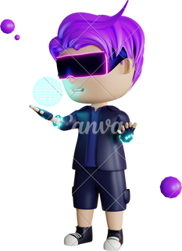
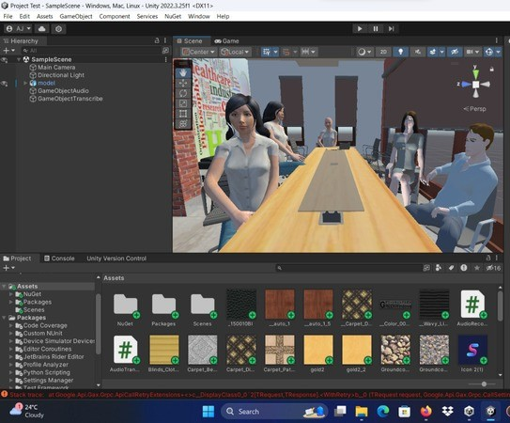
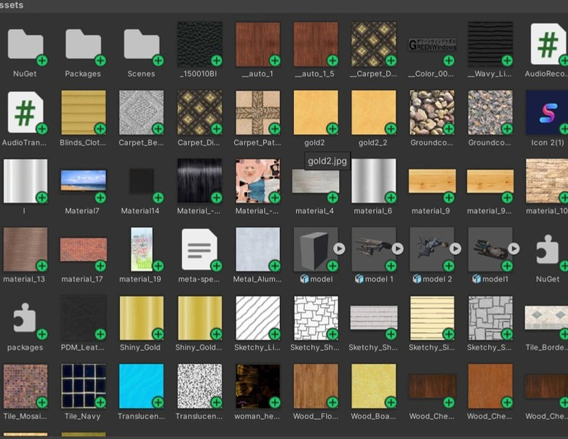
Assets and 3D models

Slide 8
BACKEND
1. Recording audio

Slide 9
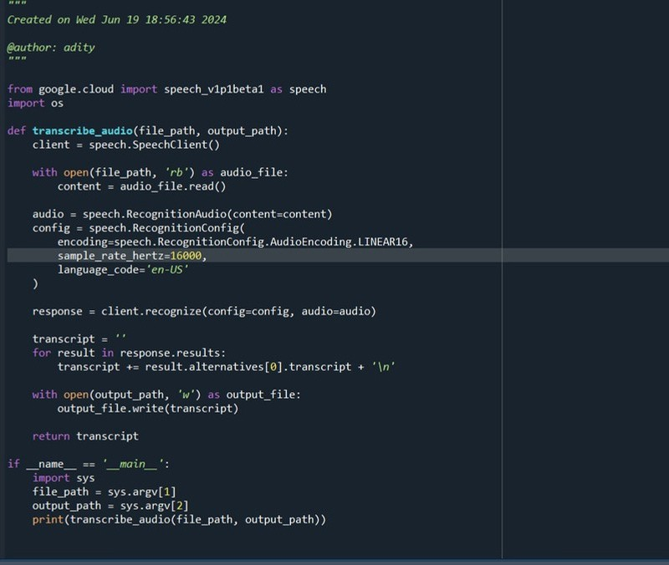
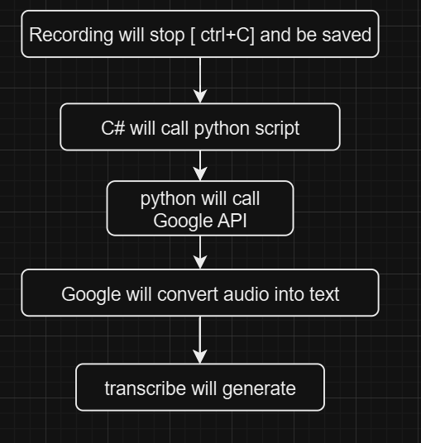
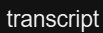
2. Transcript generation

Slide 10
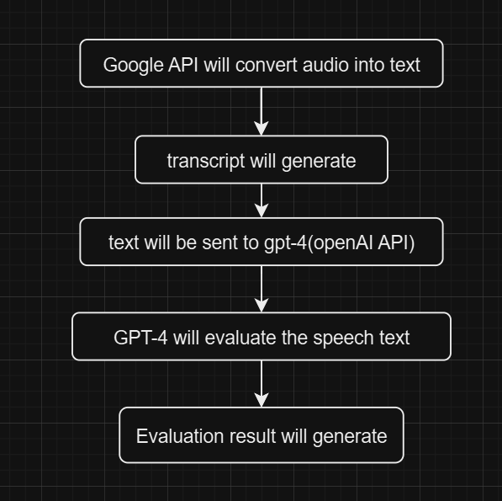
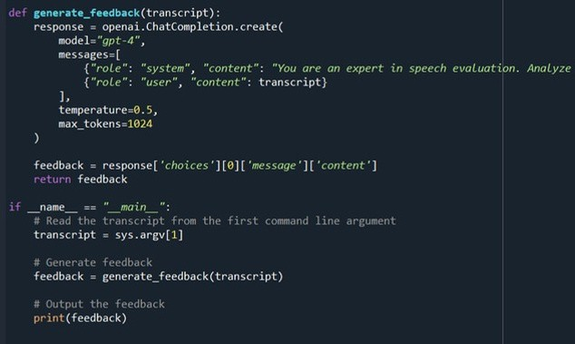
3. Performance Evaluation

Slide 11





ADDITIONAL POINTS
Future scope
1.DIFFERENT SECNERIOS AND ENVIRONMENT DEVELOPMENT 2.CUSTOMIZABLE CHALLENGES
FEEDBACK AND GESTURE ANALYTICS USING CNN
ADDING GAMIFICATION AND CHALLENGES

Slide 12


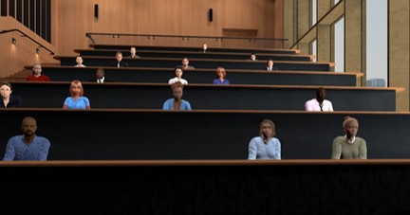

FURTHER SCENCE DEVELOPMENT

Slide 13
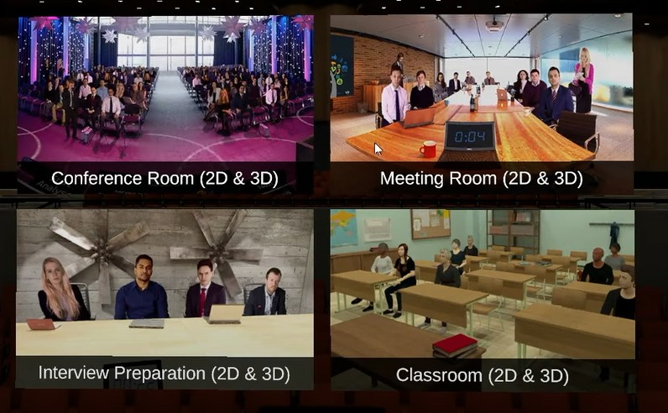
DIFFERENT ENVIRONMENTS

Slide 14
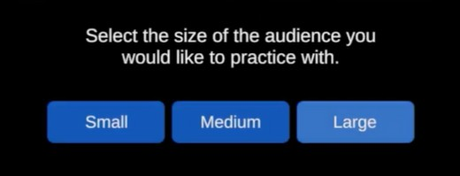
CUSTOMIZABLE CHALLENGES

Slide 15
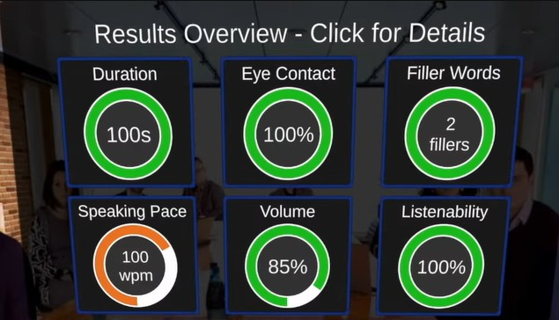
UI DEVELOPMENT
EVALUATION MATRIX

Slide 16
Sample classes
1.Doing other things 2.Rolling Hand Forward 3.Shaking Hand
4.Stop Sign 5.Swiping Left 6.Thumb Down
7. Thumb Up 8.Turning Hand Clockwise
Turning Hand Counterclockwise
Zooming Out With Full Hand 11.Zooming Out With Two Fingers
ML FOR FURTHER
EVALUATION AND GESTURE ANALYTICS

Slide 17
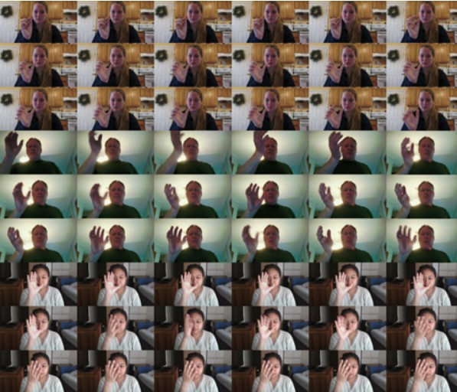

Slide 18

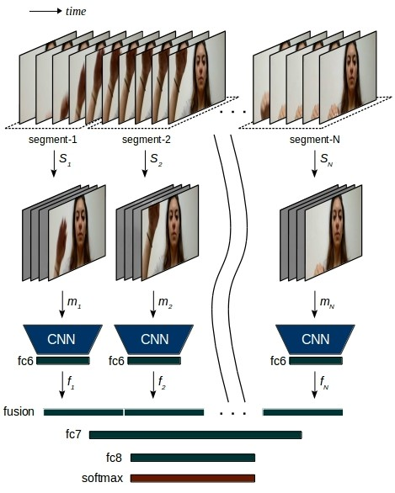



Slide 19




THANK YOU

